Slide 1

BUSINESS ANALYSIS
15th May, 2023

Slide 2
Table of Content
Company Overview |  | 3 |  | Recommendations |  | 15
 | Company Overview | 4 |  |  | NFT Market Review | 16
 | Research Methodology | 5 |  |  | Recommendation 1 | 17
 | Business Model | 6
 | Company Review | 7
 | OpenSea Analysis | 8
Industry Overview |  | 10
 | Cryptocurrency Market | 11
 | Market Capitalization | 12
 | NFT Market | 13 |  | Appendices |  | 20

Slide 3
COMPANY OVERVIEW

Slide 4
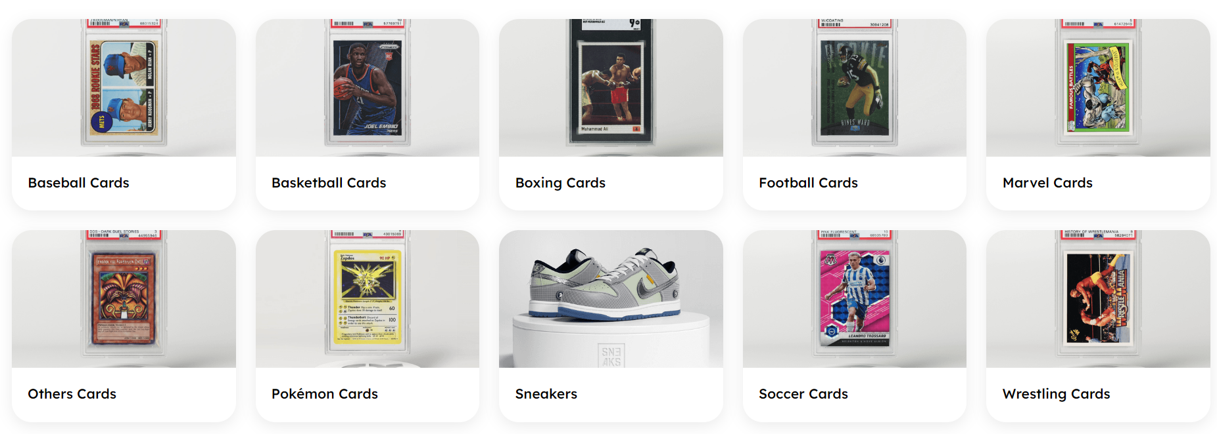
Company Overview
Company Highlights
Business Partners
Courtyard is a platform that provides liquidity to collectible assets via physically backed NFTs. It stores physical collectables in secured vaults, creates 3D representations, and mints them on the blockchain as a connected collectable.
Courtyard was founded in 2021 in the United States with the goal of becoming the most trusted platform for tokenizing and trading physically-backed NFTs.
Users of NFTs can hold their valuable collectibles as NFTs, trade their NFTs on any suitable marketplace, such as OpenSea, or burn their NFTs to reclaim the asset. When customers redeem their NFTs, courtyard ships the product to them via the Brinks worldwide infrastructure.
Mission: Courtyard's mission is to build a framework to facilitate the trading of physical assets via the blockchain.
Brinks
Y Combinator
Opensea
Cherry Venture
New Enterprise Associate
Vaynerfund
Product Categories
Problem Statement
An examination of the Courtyard Product Drop of physically backed Pokémon card NFTs, as well as a timeline of transactions and redemptions from the first drop in the year 2022.
An examination of the broad market trends for NFTs, the trading volume and value in the most well-known NFT marketplaces, and how the asset prices and trading volume of Courtyard relate to the market over this period.
1
2
3
4
Company Overview
Industry Overview
Recommendation
Team Overview

Slide 5
Research Method
Data Collection Method
Primary Data
Secondary Data
Research Approach
Quantitative Approach
1
2
3
4
Company Overview
Industry Overview
Recommendation
Team Overview

Slide 6

Business Model
IDEATION
VALUE CHAIN
IDEATION
IDEATION: Define project scope, timeline and deliverables, identify target demographics, develop released strategy, marketing strategy brainstorm, and product concept pitch.
SUPPORT
IMPLEMENTATION: Store, secure, and take inventory of physical product Smart contract implementation and deployment Integration support Custom frontend design and implementation including rendering 3D models and creating promo videos
LAUNCH: Partnerships activations, Live engineering support during minting, Coordinating with NFT marketplaces for launch and verification/handle reservation, Reveal scheduling (if applicable)
IMPLEMENTATION
LAUNCH
SUPPORT: Physical inventory management, Metadata updates, Redemption support, KYC integration ,Automated royalties support including sales and royalties reporting for tax purposesInsurance management
1
2
3
4
Company Overview
Industry Overview
Recommendation
Team Overview

Slide 7
Company Review
Pokémon Cards
Sealed Cards
The Reduction in sales of sealed Pokémon cards was caused by the crash in the crypto and NFT market in Q2 and Q3 of 2022
70%+
Unsealed Cards
Key Point
March accounted for 68% of the total sale.
June and December recorded the least sale with 0.2% and 0.4%
The decrease in sale with May and December is due to the crash in the crypto market
1
2
3
4
Company Overview
Industry Overview
Recommendation
Team Overview

Slide 8
OpenSea Analysis
Background Highlight
Bored Ape Yacht Club
OpenSea is the largest decentralized marketplace for buying and selling NFTs on the Ethereum blockchain
It has 20 collections which are categorized into gamin, membership PFPs, domain name, music, sports collectables and virtual world photography
Most Traded Asset on OpenSea
Otherdeed for Otherside
BAYC is a collection of 10,000 unique NFTs. BAYC is the second most traded NFT with a total volume of 498,644 ETH and a total number of sales records of 6,055 ETH volume.
Azuki
Otherdeed is the most traded NFT on OpenSea during the time period under consideration with an average price of 14.65 ETH and a total volume of 580,899 transactions. In February 2023, it also saw its largest sales volume of 39,386 ETH.
Azuki is a collection of hand-drawn NFT characters released in January 2022 with 10,000 collections and categorized under PFPFs collections. The total number of trades of AZUKI from April 2022 to March 2023 is 20,474 ETH and February recorded the highest sales of 4,863 ETH.
1
2
3
4
Company Overview
Industry Overview
Recommendation
Team Overview

Slide 9
OpenSea Analysis
Clone X-X Takashi Murakeami
Courtyard Asset Performance
Clone X-X Takashi Murakeami is a collection between the contemporary artist Takashi Murakami and the NFT platform Clone X. The collection currently records a total of 385,364 ETH volume. It recorded a total sales volume of 30,102 ETH in the last year and 9,956 ETH only in February 2023
Impact on Courtyard Assets
Clone X-X Takashi Murakeami
Terra UST Luna crashed in May
As a result of the crash, Courtyard Sales revenue declined by 88% in June
July Recorded the Lowest Sales with just $433 sold for the period
FTX crash in November
Total sales revenue went from $3,844 in November to $934 in December leading to a 75% decrease in total sales revenue in that period.
MAYC is a group of 20,000 distinct NFTs that depict cartoon apes with various mutations and accessories.
1
2
3
4
Company Overview
Industry Overview
Recommendation
Team Overview

Slide 10
INDUSTRY OVERVIEW

Slide 11
Cryptocurrency Market
Market Highlights
Cryptocurrency is a decentralized digital financial asset designed to be used over the Internet (Coinbase, 2023).
They are digital money whose record and transfer of ownership are guaranteed by a cryptographic decentralized technology (Giudici et al., 2019).
The first cryptocurrency (Bitcoin) was launched in 2008. It is the biggest and most popular coin in the market.
The crypto market capitalization is $1.21T (Coinbase, 2023) and Bitcoin, Ethereum, Bitcoin Cash and Litecoin are the top four most popular cryptocurrencies by Market Capitalization (Coinbase, 2023).
Number of cryptocurrencies worldwide from 2013 to February 2023
1
2
3
4
Company Overview
Industry Overview
Recommendation
Team Overview

Slide 12
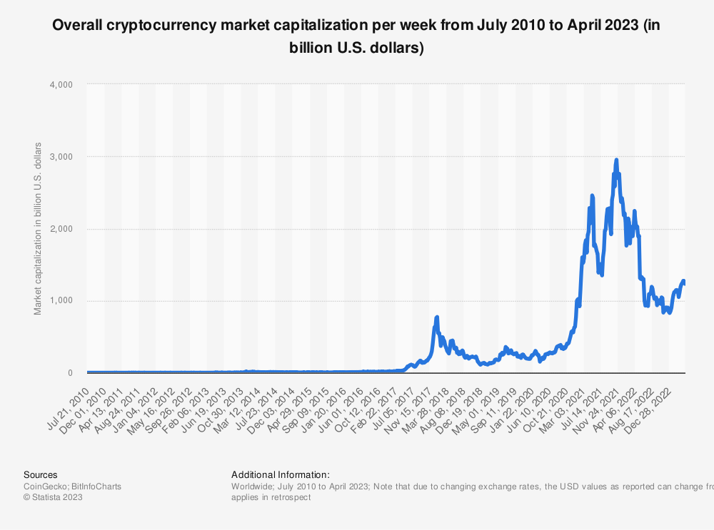
Market Capitalization
Crypto Market Cap
Crypto Market highlight in 2022
The fall in the crypto market in 2022 ultimately affected the NFT market because the NFT market is a sub-segment of the crypto market.
A decline in Courtyard’s NFT sales from Q2 of 2022 towards the end of the year.
The crypto market capitalization is $1.21T IN 2023
Impact On Courtyard
Crypto Market highlight in 2022
central banks all over the world started raising interest rates in an attempt to control inflation caused by Covid-19 and to boost economic growth
This Policy led the value of the U.S. stock market fell by more than 15%, bond market fell above 20%, and the cryptocurrency market fell by more than 50%.
By the end of the second quarter of 2022, the market cap of cryptocurrencies had dropped below $1 trillion
In Nov FTX crashed causing a shock in the market. The market value of cryptocurrencies fell from $3 trillion at its height to about $800 billion.
(Wood, 2022)
1
2
3
4
Company Overview
Industry Overview
Recommendation
Team Overview

Slide 13
Non-Fungible Tokens (NFT) Market
Market Highlights
Market Highlights In 2022
NFT is a unique identifier that represents ownership of real-world or digital assets such as art, music, collectibles, in-game items, and even real estate. These tokens are cryptographically secured in a blockchain such as Ethereum,
When purchasing one of these using a cryptocurrency like Ethereum, you get a digital, blockchain-backed certificate of authenticity. Once digital files are uploaded as non-fungible tokens on blockchains, they can be offered for sale, since it would be always possible to distinguish the original file from its copies shared online.
Quarter One Analysis
50%
Market Capitalization
The Reduction in Sales volume was due to the increase in NFT price in Q4 of 2021 and Q1 of 2022. this resulted to a 31% decrease in the number of buyers in the same period
Quarter Two Analysis
25% in traded Volume
Drop in Profit from $2.3B in Q1 to $460M in Q2
46% in profit at resale and total loss increase by 23%
Source: Statista, 2022
1
2
3
4
Company Overview
Industry Overview
Recommendation
Team Overview

Slide 14
NFT Market
Quarter Three Analysis
Courtyard Market Share
75%+
Key Highlight
A 75%+ Drop in trade Volume
Net Quarter Loss of $450M for the first time.
84% reduction in profit at resale during the period
Ethereum and Courtyard Trading Volume
Impact on Courtyard Assets
Terra UST Luna crashed in May
As a result of the crash, Courtyard Sales revenue declined by 88% in June
July Recorded the Lowest Sales with just $433 sold for the period
FTX crash in November
Total sales revenue went from $3,844 in November to $934 in December leading to a 75% decrease in total sales revenue in that period.
1
2
3
4
Company Overview
Industry Overview
Recommendation
Team Overview

Slide 15
RECOMMENDATION

Slide 16
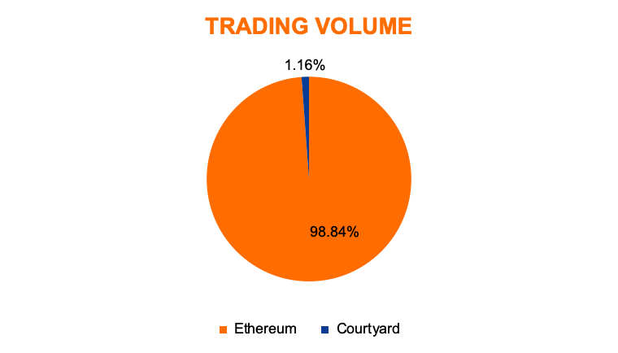
Recommendations
NFT Market Review
Users
the market for NFTs has grown exponentially in Digital art, music, and other digital assets. These assets are becoming increasingly popular on the market for non-fungible tokens.
The market has also witnessed an increase in celebrity and athlete NFTs, as well as the emergence of NFT-based gaming and virtual real estate.
Increased Adoption of Blockchain Technology for verification of digital asset ownership and authenticity.
The covid-19 pandemic has led to an increase in online activity thereby generating demand for digital assets.
The Rise of decentralised finance (DeFi) and crypto investing has increased interest in NFTs as prospective investment opportunities
Percentage of adults who own an NFT in selected countries worldwide as of Sept 2022
Untapped Market
Untapped Opportunities
Courtyard can leverage the exponential growth in the market and its adoption of blockchain by expanding its offerings to include the untapped connected collectible market in Asia. This opportunity will increase its market share and profitability if leveraged.
Source: Statista, 2022
1
2
3
4
Company Overview
Industry Overview
Recommendations
Team Overview

Slide 17
Recommendations
NFT Market Outlook
The NFT market is expected to continue growing in the coming years.
This growth will be driven by increasing mainstream adoption, as more individuals become aware of NFTs and their potential applications, and the emergence of new use cases for the technology.
However, risks and difficulties are associated with the market, such as environmental impact concerns and the possibility of speculative surges forming. As a result, the market will likely experience both ups and downs as it matures and develops in the future.
Recommendation 2
Courtyard can introduce the initiative of physically backed NFT to other brands by offering to convert their physical assets like football players, and residential and commercial real estate into collectibles.
In the future NFT will be used to symbolize ownership of tangible assets like real estate and football players This gives Courtyard a competitive advantage if its technology could be leveraged to tap into this opportunity.
(Natalee, 2023).
1
2
3
4
Company Overview
Industry Overview
Recommendations
Team Overview

Slide 18
TEAM OVERVIEW

Slide 19
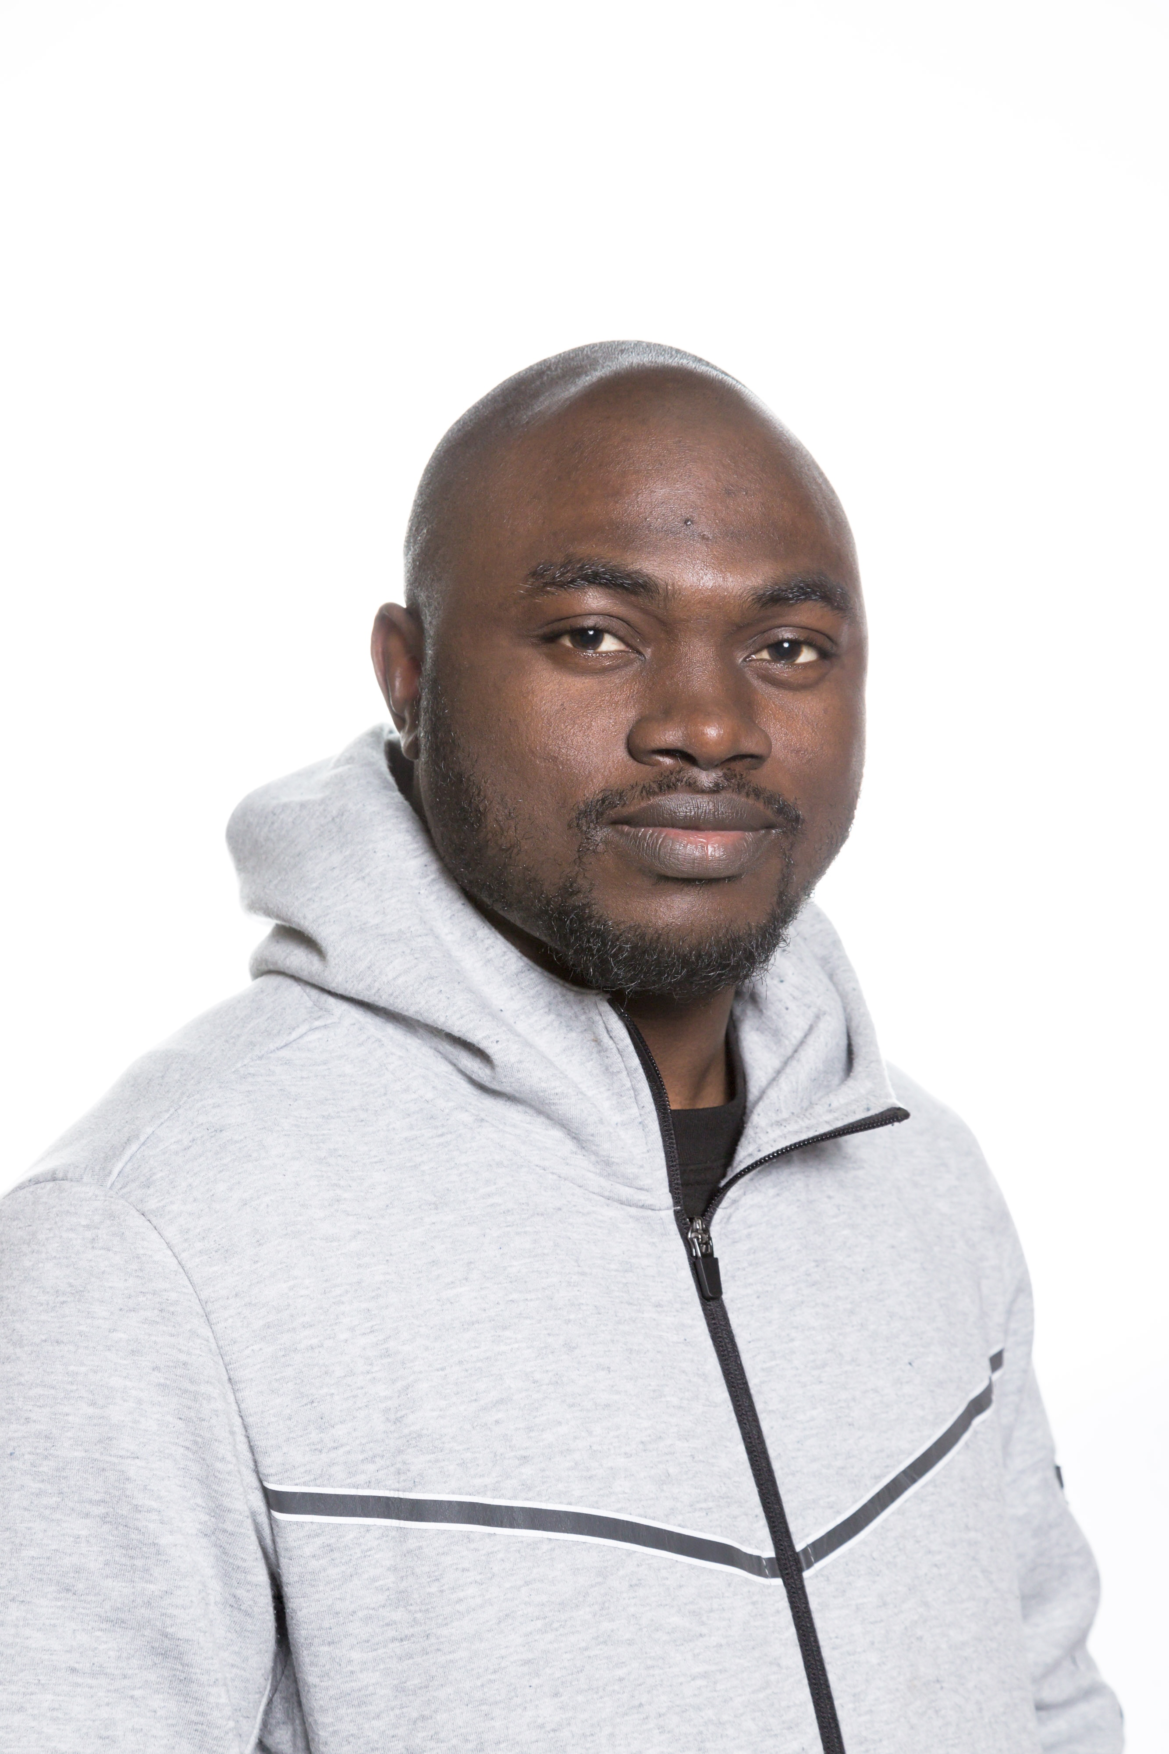
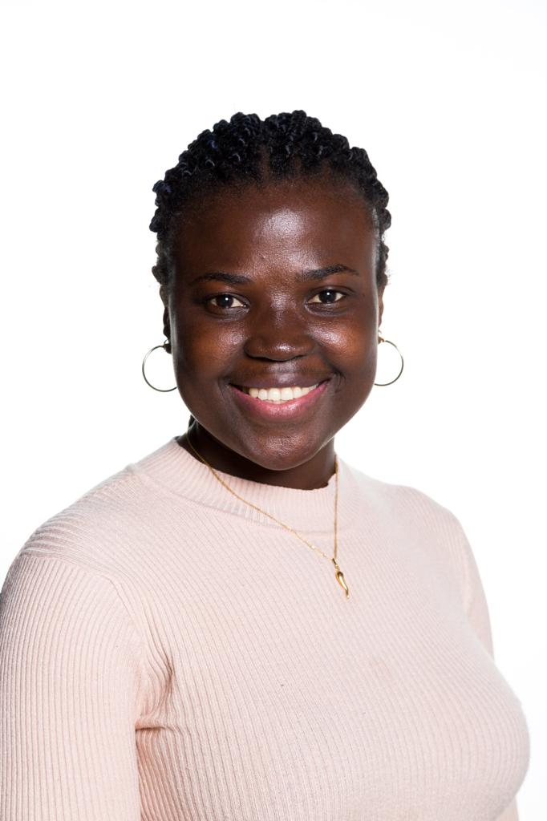

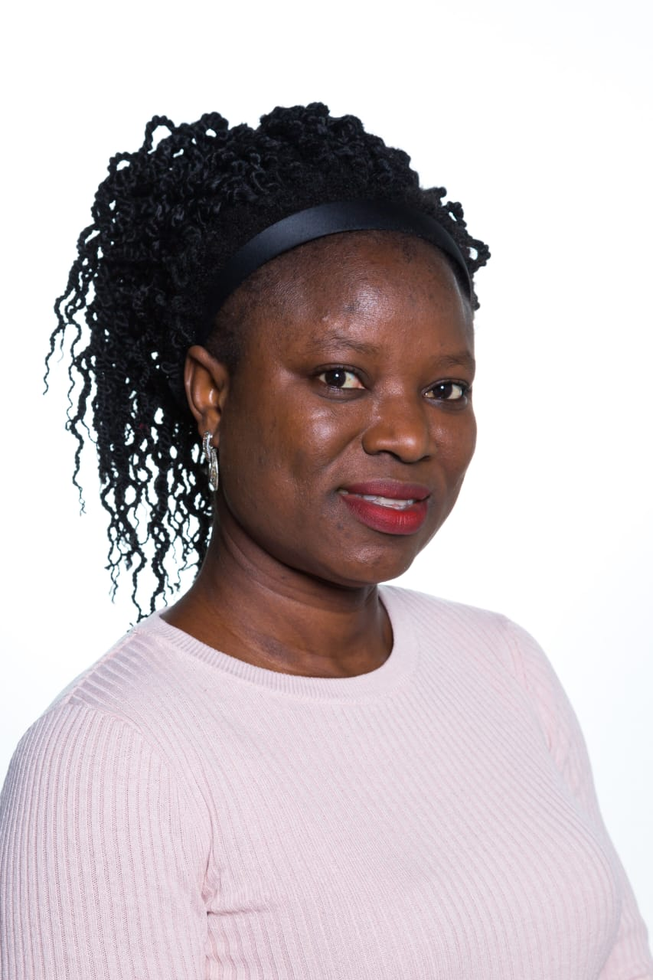

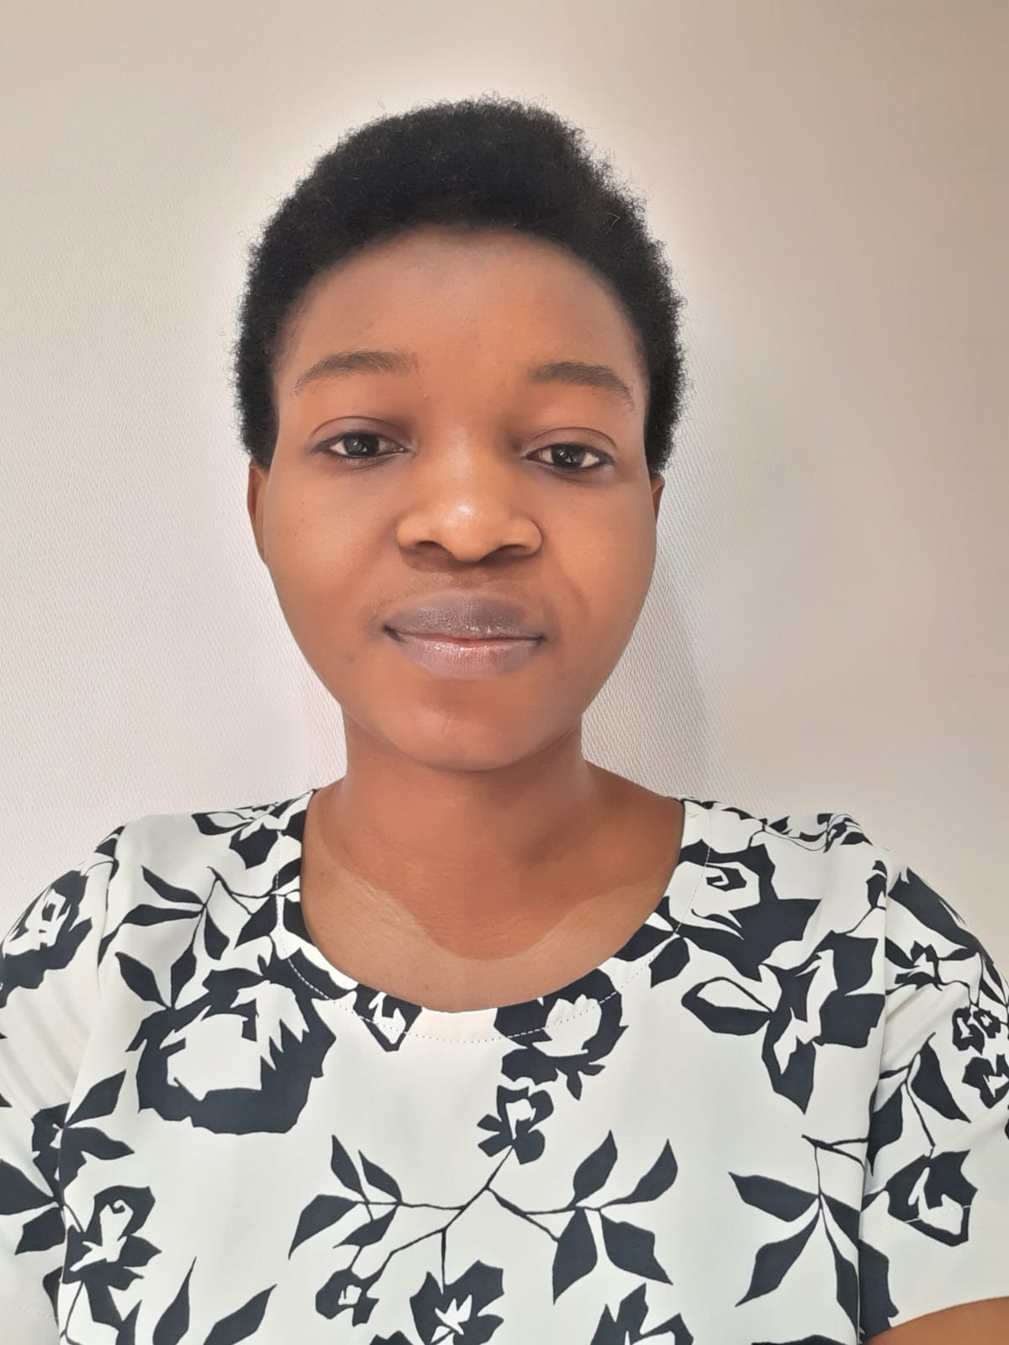
Team Composition
Harrison Obamwonyi
Folake Monsurat Ajao
Olashile Mariam Oladunni
Gbemisola Tosin Ibitomi
Taiwo Eniola Damisa
Praise Ekebafe
1
2
3
4
Company Overview
Industry Overview
Recommendation
Team Overview

Slide 20
THANK YOU

Slide 21
APPENDICES

Slide 22
Appendices
Otherdeed for Otherside Data
Mutant Ape Yacht Club (MAYC)
Bored Ape Yacht Club (BAYC)
AZUKI

Slide 23
Appendices
Clone X-X Takashi Murakami
Most Traded Courtyard Asset in 2022
Courtyard Asset performance

